Slide 1
Car Rental Application
Developing a Java-based application with SQL and JDBC

Slide 2

Introduction
This presentation explores the development of a Car Rental Application using Java, SQL, and JDBC. We will cover user and admin features, the project structure, and database design.

Slide 3
01
User Features

Slide 4
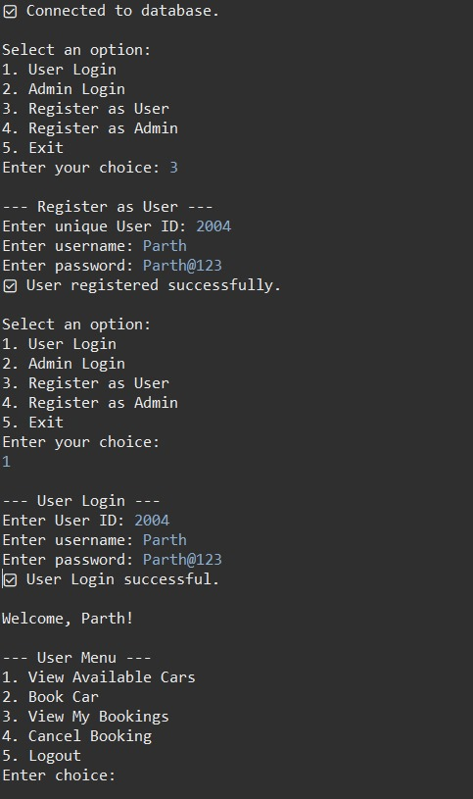
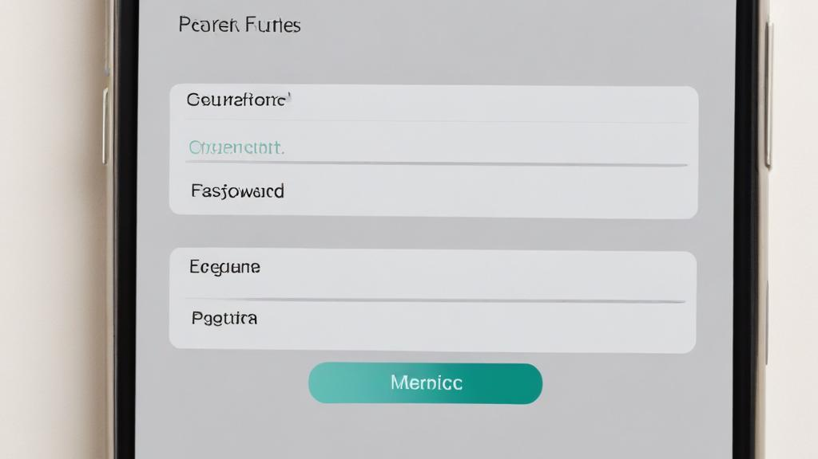
Register/Login functionality
This feature allows users to securely register and log into their accounts using authentication mechanisms. It ensures that user data is protected and provides a personalized experience. Through this feature, users can create profiles, manage their credentials, and recover forgotten passwords.

Slide 5
View Available Cars feature
Users can browse a comprehensive list of rental cars filtered by type, availability, and price range. This feature includes searching, sorting, and viewing detailed information about each car, including images, specifications, and rental rates, enabling users to make informed choices.

Slide 6
Book and View Booking History
This feature enables users to book a car for a specified duration and view their past bookings. Users can select the car, duration, and additional options, and the system will confirm the booking and provide a summary. The booking history section allows users to track their past rentals, along with details such as rental dates, cars booked, and total charges, facilitating easier re-rentals and management of booking information.

Slide 7
02
Admin Features

Slide 8
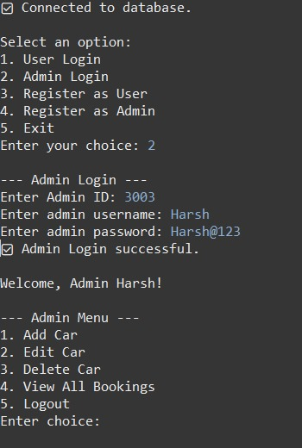
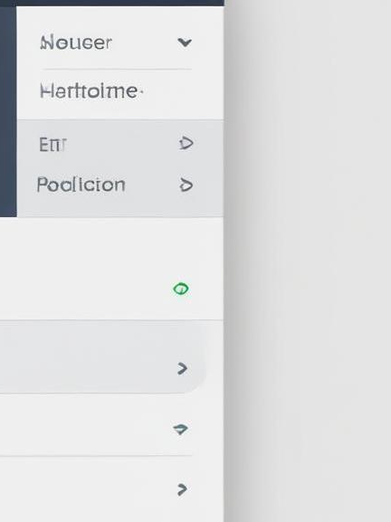
Manage Cars (Add/Edit/Delete)
Admins can efficiently manage the fleet of cars available for rent. This includes adding new cars, editing existing car details (like model, price, and availability), and deleting cars that are no longer in service. The admin interface provides easy tools for entering car specifications and uploading images, ensuring that the data stays up to date. All changes are reflected in real-time for user visibility.

Slide 9
View All Bookings management
This feature allows administrators to view and manage all active and past bookings in the system. Admins can filter bookings based on date, car type, or user, allowing for easy monitoring of rental activity. It also offers functionalities for updating or canceling bookings, ensuring that booking records are accurate and users are appropriately notified of changes.

Slide 10
Car Availability Management
Admins can view and manage the availability of each vehicle in real-time. They can mark cars as available or unavailable based on maintenance schedules or other factors. The system automatically updates the availability status in the user interface, ensuring that users can only book cars that are currently available. This feature is crucial for maintaining accurate fleet management and improving customer satisfaction.

Slide 11
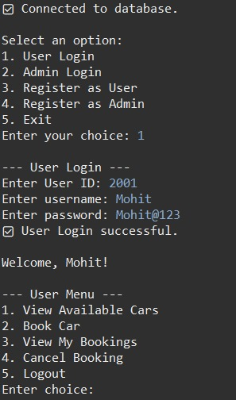
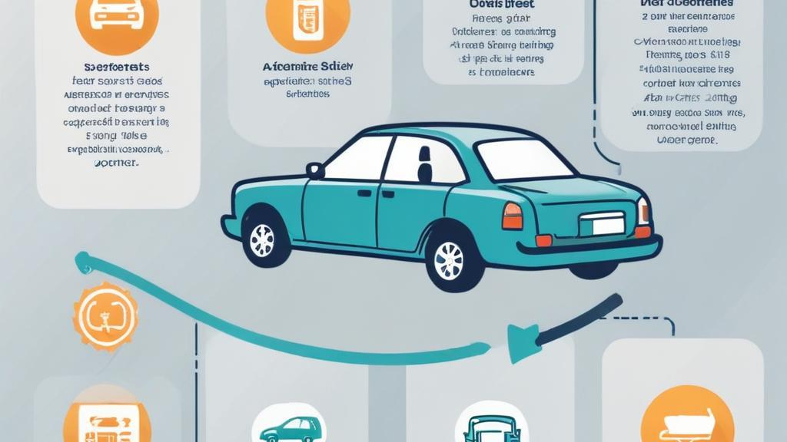
Conclusions
In summation, the Car Rental Application provides a comprehensive solution for both users and administrators. Users benefit from an intuitive interface with easy booking processes, while admins have powerful management tools at their disposal. The implementation of Java, SQL, and JDBC technologies ensures robust functionality, enhancing overall user experience and operational efficiency.

Slide 12
Thank you!

